Slide 1

Predicting Future With Social Networks
Maciej Medyk

Slide 2

Agenda
Description of Social Media
Social Media Current Use in Future Prediction
Why Social Media Data Is Useful in Prediction?
Research Goals set by Authors
Sitaram Asur and Bernanrdo Huberman Experiment
Message Semantics Recognition
Findings and Conclusion

Slide 3
What is Social Media?
Platform that connects people that want to form relationships and friendships with others
Allow individuals to group together under specific entity like country, company, or interest page
Users can post and share experiences and ideas
Users can express feedback through likes and comments about posts they see
Social Media tracks user metadata like important dates, hometowns, schools, jobs, relationships, interests, etc.

Slide 4
Social Media Areas of Future Prediction
Social Media is focused on our emotional attachment to the world around us
Access to voluntarily shared honest raw data entered by the public
People become more intimate with their social status on Social Media
Areas of prediction need to be emotionally driven rather than logically driven

Slide 5
Social Media Data Use in Analytics
Conversations on social media are indicators of popularity and hype
People are likely to talk about new products, services, political events, religion, work trends, etc.
Observe trends through looking into rate of tweets, likes (like love funny wow sad angry), and comments
Establish data semantics through sentiment analysis

Slide 6
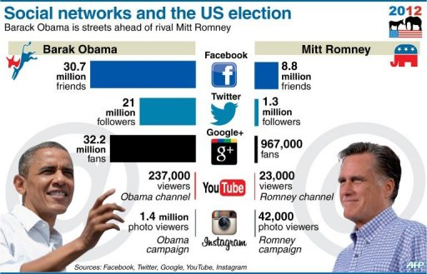
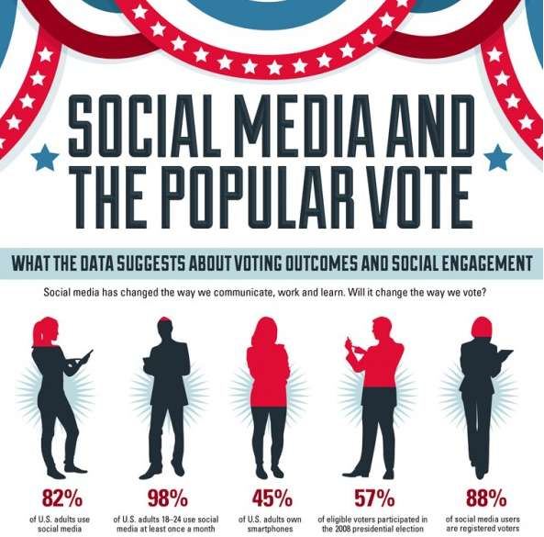
Current Use Social Media in Predictions
Social Media used in political forecasting
Candidate momentum and likeability
Voter enthusiasm and turnout
Organized event predictions
Terrorism or hate crime prediction
Product desirability predictions
Financial prediction about stock prices

Slide 7
Research Paper Goals Set by Authors
Assess how buzz and attention is created for different movies and how they change over time.
Analyze the mechanism of viral marketing and pre-release hype Twitter and the role it plays in forecasting real world box office performance.
Analyze how sentiments are created and how positive and negative sentiments correlate with box office performance and how they influence people.

Slide 8
Asur and Huberman Research Setup
Movie box office prediction based on Twitter data
Sample of 2.89 million tweets from 1.20 million users over three month period focused on 24 movies
Monitoring rate of tweets over critical period of three weeks starting one week before movie releases and filtering promotional materials containing URL links from retweets by potential movie goers.
Use of linear regression to establish relationship between Twitter activity data and box office results

Slide 9
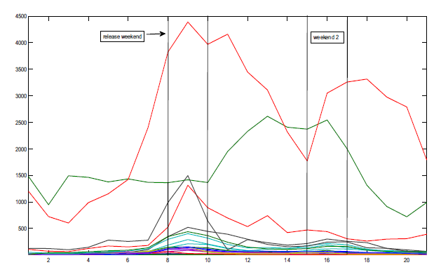
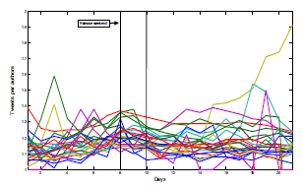
Asur and Huberman Initial Data Analysis
Tweets were organized in three week intervals from one week before release to two weeks after release of the movie.

Slide 10



Semantics Recognition
Sentiment analysis
Subjectivity analysis
Polarity analysis

Slide 11
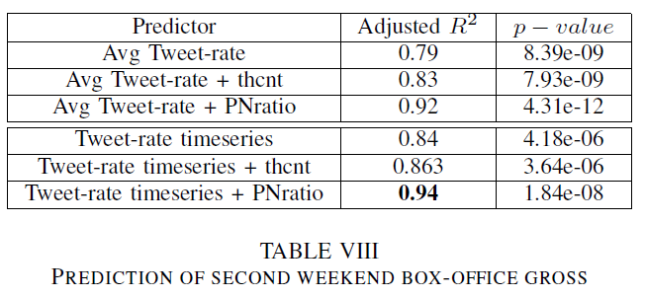
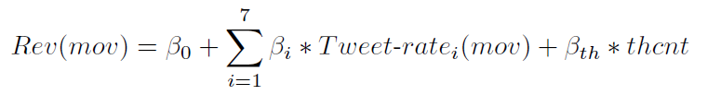

Asur and Huberman Research Analytics

Slide 12
Findings and Conclusions
Authors used many evaluation techniques using tweet rate, theater count, sentiment PN ratio
The correlation of tweet rate together with amount of theaters screening the movie was 86% while correlation of tweet rate together with polarity PN ratio was 94%.
The findings showed that the size and amount of positive chatter on Twitter was closely related to box office results suggesting that performance of the movie can be predicted looking at size of traffic and the message sentiment.

Slide 13
Thank You
Questions

